Slide 1
Perception and Animation

Slide 2
Pre-attentive processing
How many 3’s?
1281768756138976546984506985604982826762
9809858458224509856458945098450980943585
9091030209905959595772564675050678904567
8845789809821677654876364908560912949686

Slide 3
Pre-attentive processing
How many 3’s?
1281768756138976546984506985604982826762
9809858458224509856458945098450980943585
9091030209905959595772564675050678904567
8845789809821677654876364908560912949686

Slide 4
Pre-attentive processing
Is there a red-circle in the following image?

Slide 5
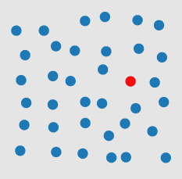
Pre-attentive processing

Slide 6

Pre-attentive processing
Is there a red-circle in the following image?
YES!

Slide 7
Pre-attentive processing
Is there a red-circle in the following image?

Slide 8
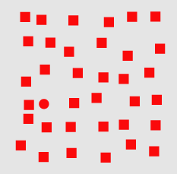
Pre-attentive processing

Slide 9
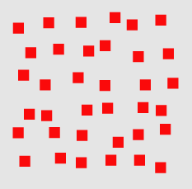
Pre-attentive processing
Is there a red-circle in the following image?
YES!

Slide 10
Pre-attentive processing
Certain visual features can be processed before a viewer focuses attention
Usually defined as <250ms
Eye movements take >200ms to react

Slide 11
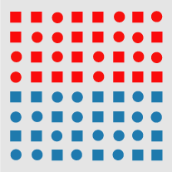
Pre-attentive processing
Can be applied to different tasks:
Target identification
Boundary detection
Counting

Slide 12
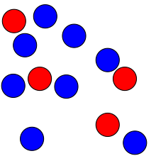
Pre-attentive processing
Pre-attentive counting: subtizing
Humans can usually count up to 4-5 elements in parallel
Beyond that counting time increases dramatically
How many red circles?
How may blue circles?

Slide 13

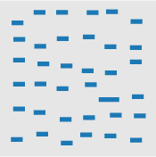

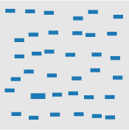
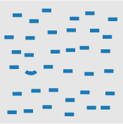
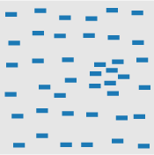
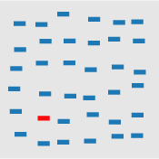
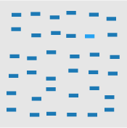
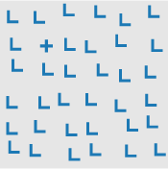
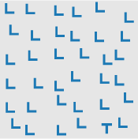
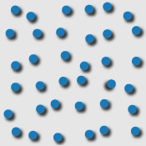
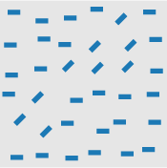
Pre-attentive processing

Slide 14
Pre-attentive processing
Is there a red-circle in the following image?

Slide 15
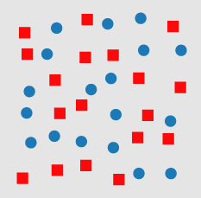
Pre-attentive processing

Slide 16
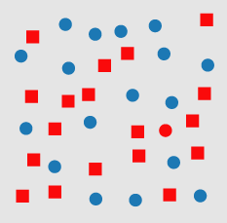
Pre-attentive processing
Conjunctions of features are usually not pre-attentive

Slide 17
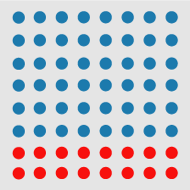
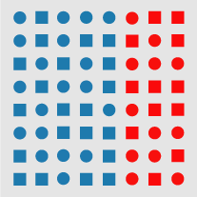

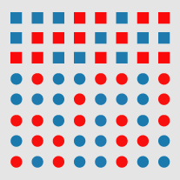
Pre-attentive feature hierarchies
Color is generally prioritized over shape

Slide 18
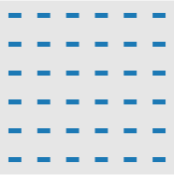
What about animation?
Motion generally is a pre-attentive feature!
We are highly sensitive to motion, stronger than color & shape!

Slide 19
Gestalt Principles
Set of principles for how humans perceive images
Outlined by by the Gestalt Psychologists incl. Max Wertheimer (1880-1943), Wolfgang Köhler (1887-1967) and Kurt Koffka (1886-1941)
Focus on how to we group elements in an image

Slide 20

Gestalt Principles: figure-ground
We separate images into a subject (figure) and background
The figure is the dominant shape in the image
This can be ambiguous!

Slide 21
Gestalt Principles: proximity
In the following picture are the dots organized in columns or rows?

Slide 22
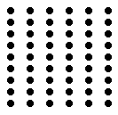
Gestalt Principles: proximity
In the following picture are the dots organized in columns or rows?

Slide 23
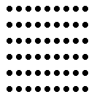
Gestalt Principles: proximity
In the following picture are the dots organized in columns or rows?

Slide 24
Gestalt Principles: proximity
Why?
Group objects based on their relative proximity

Slide 25
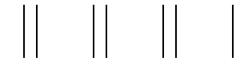
Gestalt Principles: proximity
Why?
Group objects based on their relative proximity
Three groups of 2 and one lone line:

Slide 26

Gestalt Principles: proximity
In the following picture are the dots organized in columns or rows?

Slide 27

Gestalt Principles: similarity
In the following picture are the shapes organized in columns or rows?

Slide 28
Gestalt Principles: similarity
In the following picture are the shapes organized in columns or rows?

Slide 29
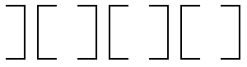
Gestalt Principles: closure
Do you see 3.5 squares or 2.5 “I” shapes?

Slide 30
Gestalt Principles: closure
Do you see 3.5 squares or 2.5 “I” shapes?
Probably squares!
Tend to prefer “closed” shapes

Slide 31

Gestalt Principles: smallness
Do you see a black cross or a white cross?

Slide 32
Gestalt Principles: smallness
Smaller shapes are more likely to be seen as the “figure”

Slide 33
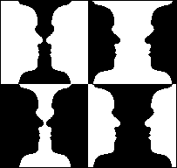
Gestalt Principles: smallness

Slide 34
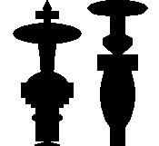
Gestalt Principles: Symmetry
Symmetrical shapes are more likely to be seen as the “figure”

Slide 35
Gestalt Principles: Symmetry
Even over the principle of smallness!

Slide 36
Gestalt Principles: Symmetry
Did you see this shape?

Slide 37

Gestalt Principles: Surroundedness
Areas surrounded by another color a more likely to be seen as the figure

Slide 38
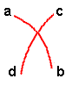
Gestalt Principles: Continuity
Does a connect to b, c, or d?

Slide 39
Gestalt Principles: Continuity
Does a connect to b, c, or d?
Prefer smooth continuity

Slide 40
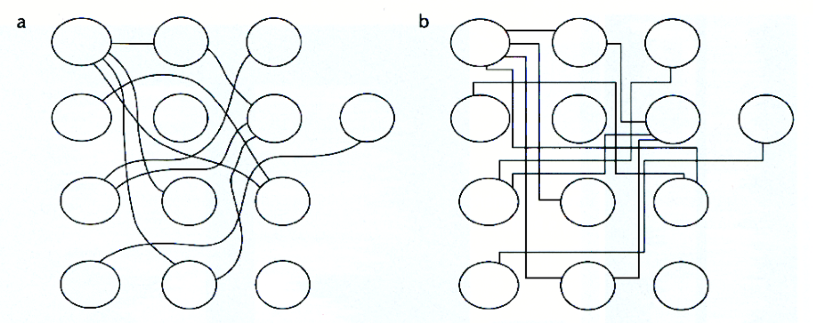
Gestalt Principles: Continuity

Slide 41
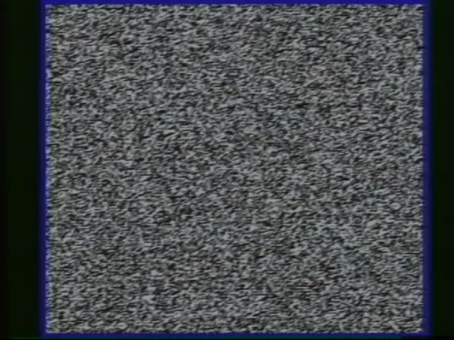
Gestalt Principles: animation
Similar motions are perceived as a group!

Slide 42
Gestalt Principles: Continuity
Continuity is very important for motion!

Slide 43

Lack of continuity

Slide 44

Presence of continuity

Slide 45
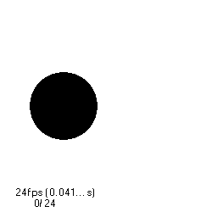
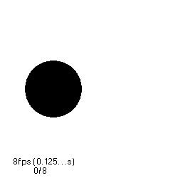

Perceiving animation
Motion perceived at about 10 fps
Need at least 20-30 fps for smoothness

Slide 46
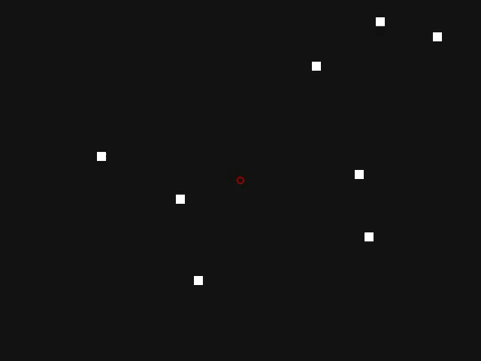
Tracking motion
We are limited in our ability to track uncorrelated motion
About 4 objects is the limit

Slide 47
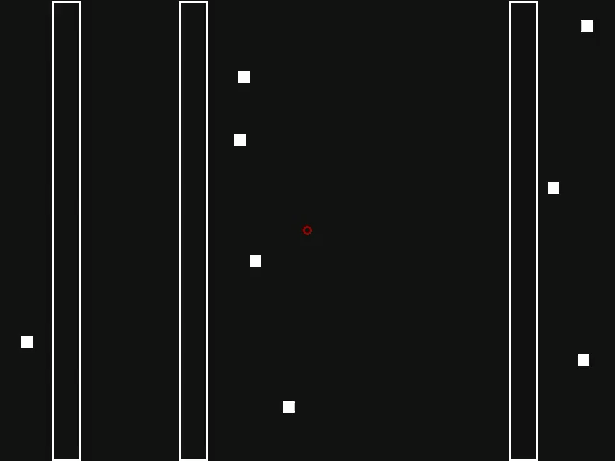
Tracking motion
Can usually deal with occlusion

Slide 48
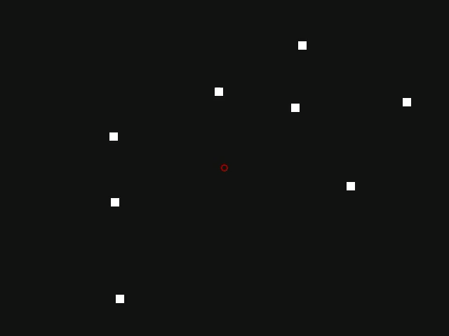
Tracking motion
Even virtual occlusion

Slide 49
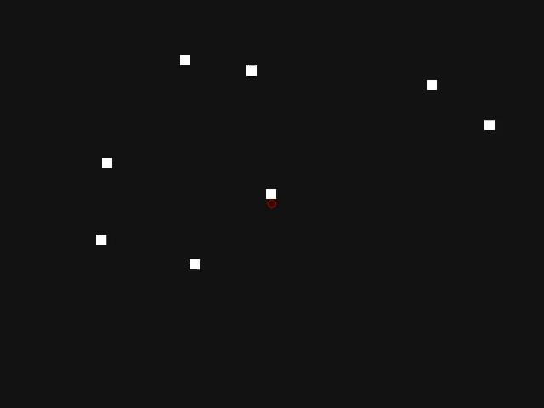
Tracking motion
Other animations make this much harder

Slide 50

Causality
Hard-wired to infer causality from motion

Slide 51
Causality
Hard-wired to infer causality from motion

Slide 52
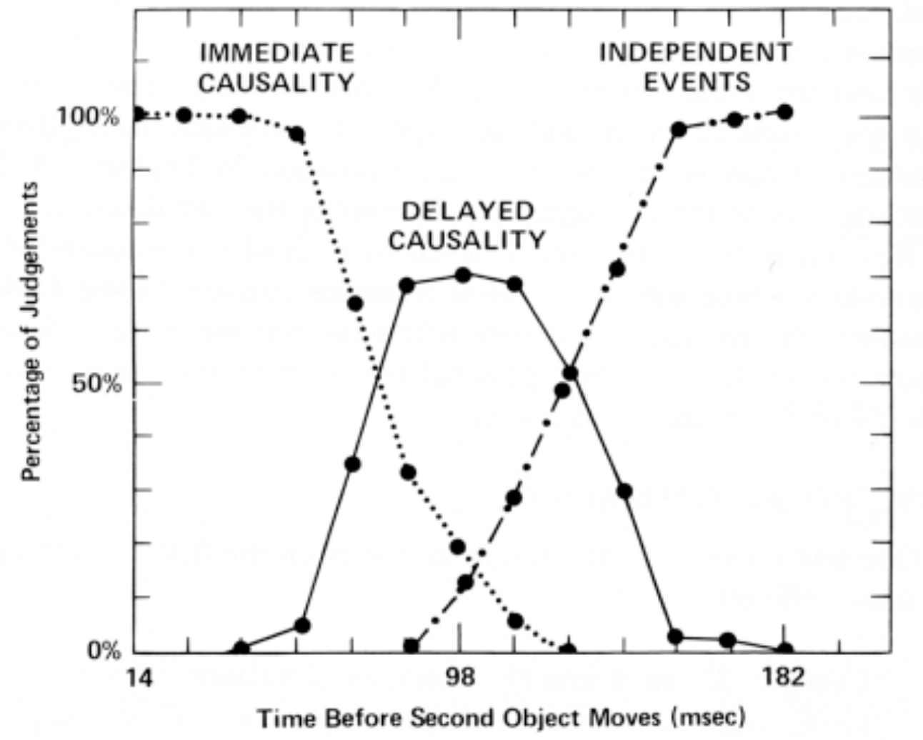
Causality

Slide 53

Storytelling

Slide 54
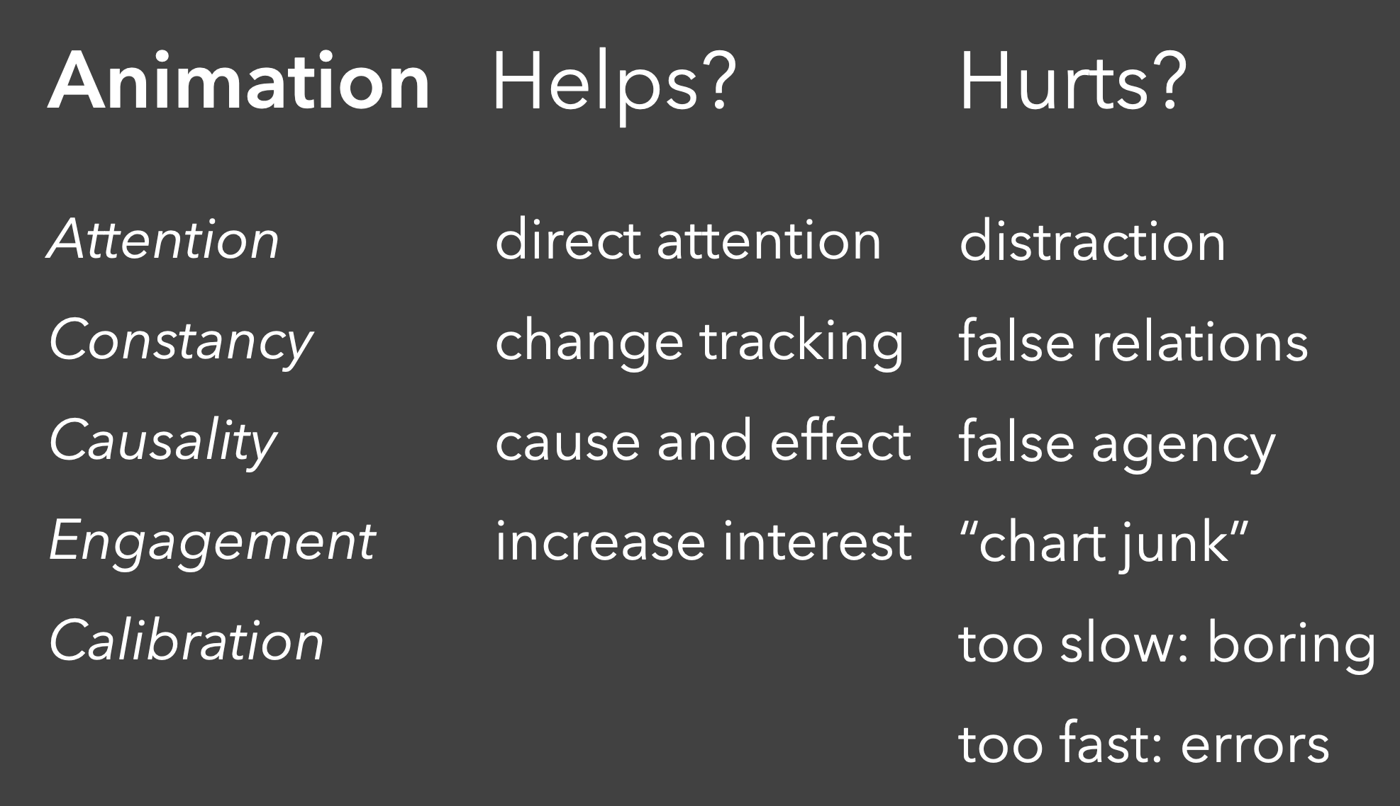

Slide 55
Animation principles (Heer)
Don’t change aesthetic mappings or scales if possible
Respect correspondence, geometries should always represent the same observation
Minimize occlusion
Maintain vaild data graphics during transitions
Use simple transitions
Use staging for complex transitions
Group similar transitions
Different operators should have distinct animations

